Slide 1


C.AI.R.A Education
InnovAIte Hackathon
A Gateway For Frictionless learning
Presented by- Jiya, Adrian and Advik

Slide 2

Problem Statement:
Current Challenges in Evaluating Student Performance
1
Lack of Comprehensive Assessment
Traditional evaluation methods often fail to capture the full spectrum of a student's capabilities.
2
Manual Review Overload
Educators are burdened with the time-consuming task of manually assessing student responses and interactions.
3
Difficulty in Identifying Trends
Recognizing patterns and trends in student participation and comprehension can be challenging.

Slide 3




Solution:
How Does Our Generative AI work?
AI-Powered Analysis
Personalised Responses
Disrupting Education
Our software harnesses the power of AI to interpret the question and provide lesson plans uniquely to your needs.
Tailored to teachers needs and gives real-time personalised reports.
Enhances education and disrupts learning systems.

Slide 4




Key Features and Benefits of the Software
Personalisation
User Friendly
Immediate Answers
We make it easier for educators to generate lesson plans and receive resources to enhance education systems
Our website is easy to use and offers a user friendly software that teachers can use anytime and anywhere
Our website gives quick answers to any questions you might have concerning the topic

Slide 5
CODE DEMO

Slide 6

Application in Diverse Education Scenarios
With our software, educators gain access to powerful tools that enable them to assess student progress, facilitate interactive discussions, and personalize learning experiences to meet individual needs. This ensures an inclusive and engaging educational environment that fosters growth and success.

Slide 7

Competitive Analysis: Comparison with Existing Evaluation Methods
Traditional Assessment
Manual and time-consuming process.
Lacks real-time insights and personalized feedback.
Standard Evaluation Tools
Limited in capturing nuanced student interactions.
May not provide in-depth comprehension analysis.
Other AI Solutions
Some are not specifically tailored for educational contexts.
May lack comprehensive student performance assessment.

Slide 8
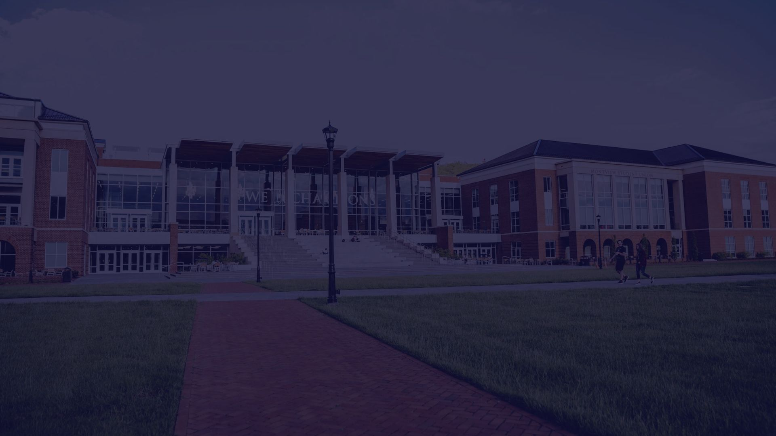
Our Target Market
Educational institutions such as schools, colleges, and learning centers, seeking to enhance their learning experiences through AI-integrated software solutions
An estimated 10,000 institutions in our target market

Slide 9

Revenue Projection
Assuming an initial adoption rate of 5% and an annual subscription fee of $1,000 per institution, we anticipate reaching 500 institutions in the first year, resulting in potential revenue of $500,000.
As the adoption rate grows by 10% annually, we project revenue to increase accordingly, potentially reaching $731,000 by the fifth year.
However, actual revenue may vary based on market conditions, competitive landscape, and the effectiveness of our marketing and sales strategies.

Slide 10

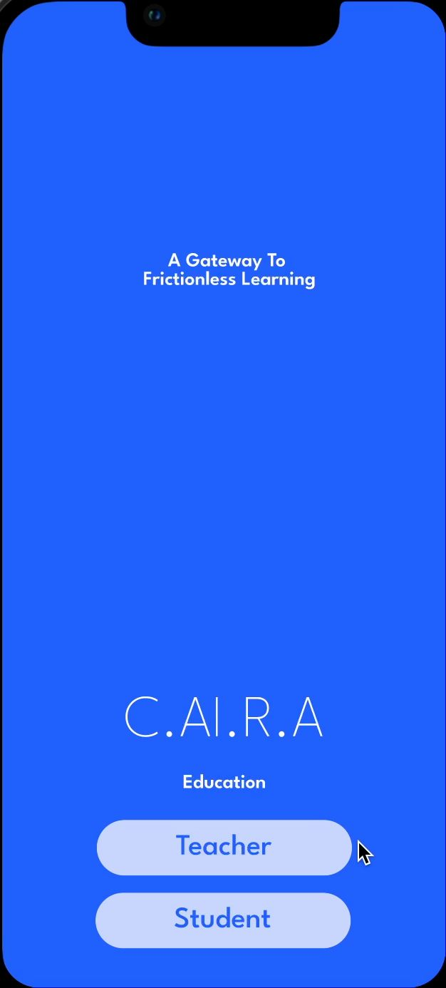
Our Vision for the Future
In the next 5-10 years, we envision C.AI.R.A Education becoming a global leader in educational technology, revolutionizing the way students learn and educators teach through cutting-edge innovations. We want to add a section that helps students as well, where they can view missed lessons in a more fun and interesting way. We will also be adding a chatbot that can answer any questions that the student might have. This will also help parents track student progress and get real time advice from the teacher.

Slide 11
Thank You for Your Support
We would like to express our deepest gratitude for your continued support and interest in our mission to revolutionize education. With your help, we are making a positive impact on students' lives.
Thank you once again for being a part of our journey!

